Slide 1
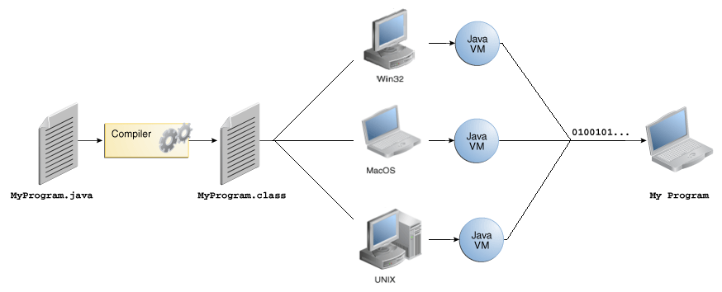
JAVA, CLASS, JVM, JRE

Slide 2
VÝHODY A NEVÝHODY JAZYKA JAVA
Jednoduchý
Objektovo orientovaný
Distribuovaný
Multithreaded
Robustný
Bezpečný
Prenositeľný
Platformovo neutrálny
Vysoko výkonný
Interpretovaný
Najpoužívanejší
Najviac pracovných príležitostí
Dobre zdokumentovaný
Automatická správa pamäte
Množstvo dostupných knižníc
Je úplne zadarmo
Interpretovaný
Boli reportované bezpečnostné nedostatky

Slide 3
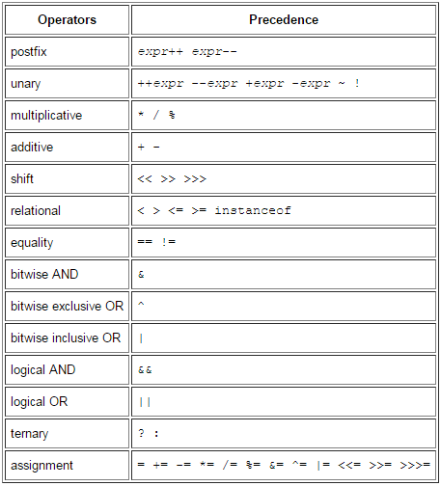
JAVA OPERÁTORY

Slide 4
KĽÚČOVÉ SLOVÁ JAZYKA JAVA
abstract | continue | for | new | switch
assert | default | goto | package | synchronized
boolean | do | if | private | this
break | double | implements | protected | throw
byte | else | import | public | throws
case | enum | instanceof | return | transient
catch | extends | int | short | try
char | final | interface | static | void
class | finally | long | strictfp | volatile
const | float | native | super | while

Slide 5
PRIMITÍVNE TYPY PREMENNÝCH
abstract | continue | for | new | switch
assert | default | goto | package | synchronized
boolean | do | if | private | this
break | double | implements | protected | throw
byte | else | import | public | throws
case | enum | instanceof | return | transient
catch | extends | int | short | try
char | final | interface | static | void
class | finally | long | strictfp | volatile
const | float | native | super | while

Slide 6
RIADENIE TOKU PROGRAMU
abstract | continue | for | new | switch
assert | default | goto | package | synchronized
 | do | if | private | this
break |  | implements | protected | throw
 | else | import | public | throws
case | enum | instanceof | return | transient
catch | extends |  |  | try
 | final | interface | static | void
class | finally |  | strictfp | volatile
const |  | native | super | while

Slide 7
PRÁCA S VÝNIMKAMI
abstract |  |  | new
assert |  | goto | package | synchronized
 |  |  | private | this
 |  | implements | protected | throw
 |  | import | public | throws
 | enum | instanceof |  | transient
catch | extends |  |  | try
 | final | interface | static | void
class | finally |  | strictfp | volatile
const |  | native | super

Slide 8
MODIFIKÁTORY
abstract |  |  | new
 |  | goto | package | synchronized
 |  |  | private | this
 |  | implements | protected
 |  | import | public
 | enum | instanceof |  | transient
 | extends
 | final | interface | static | void
class |  |  | strictfp | volatile
const |  | native | super

Slide 9
DEKLARÁCIA TRIED, PRÁCA S OBJEKTAMI
 |  |  | new
 |  | goto | package
 |  |  |  | this
 |  | implements
 |  | import
 | enum | instanceof
 | extends
 |  | interface
class
const |  |  | super

